Slide 1
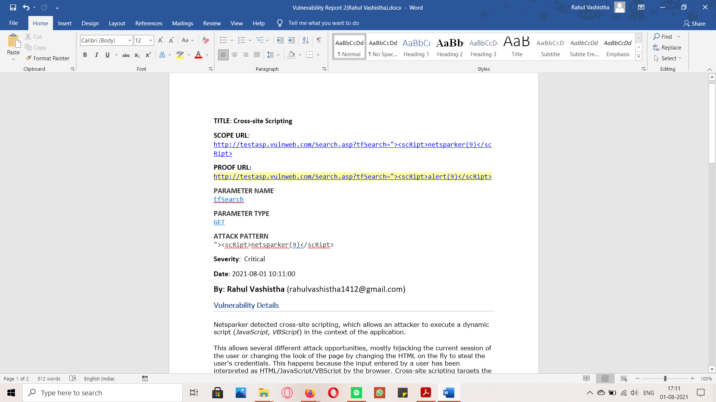

Slide 2
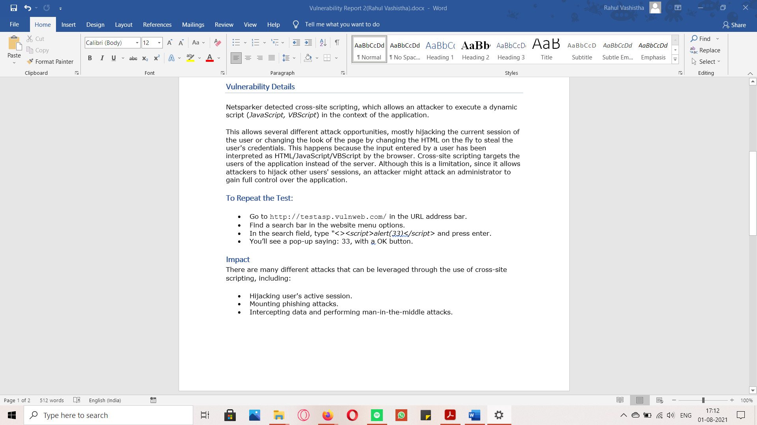

Slide 3
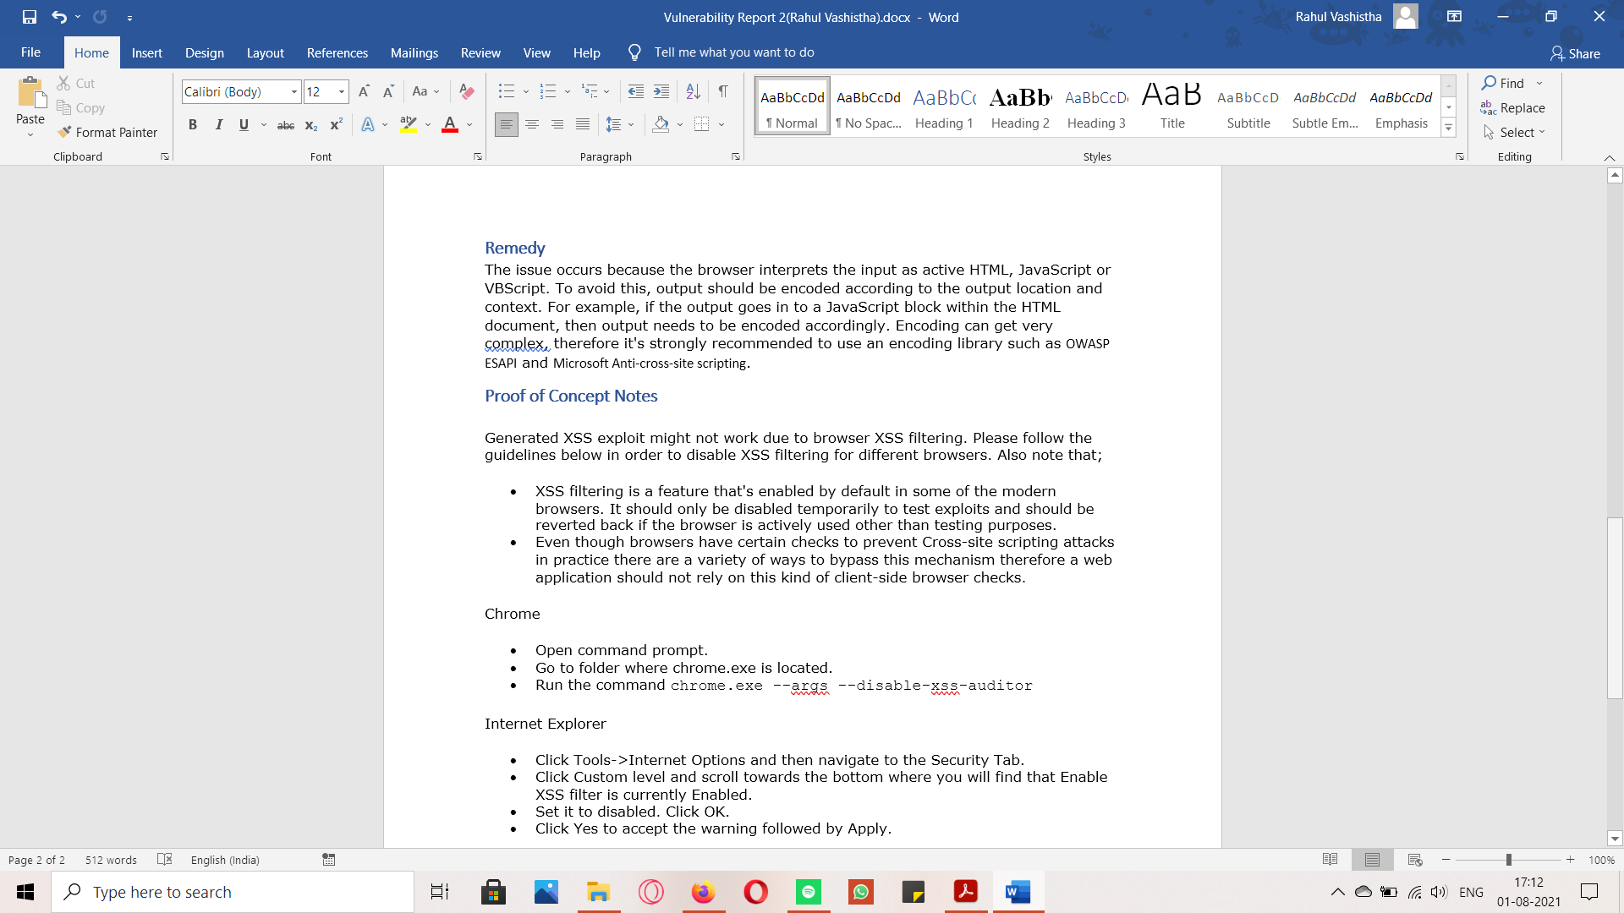

Slide 4
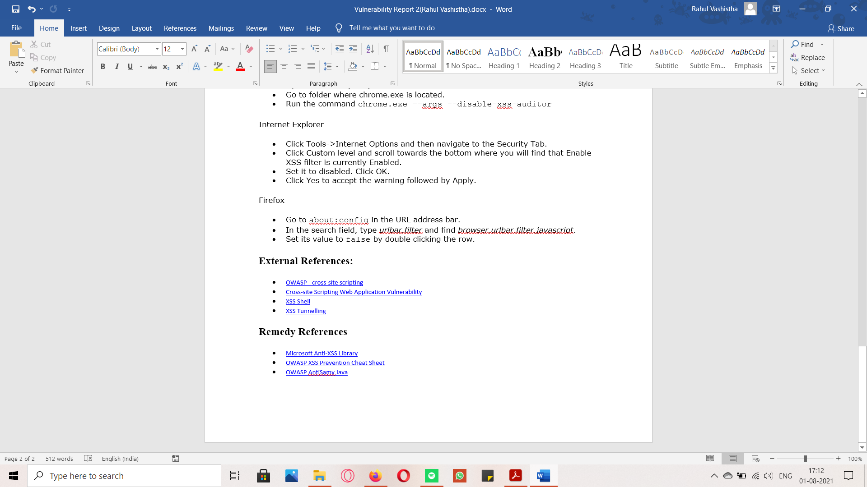

Slide 5
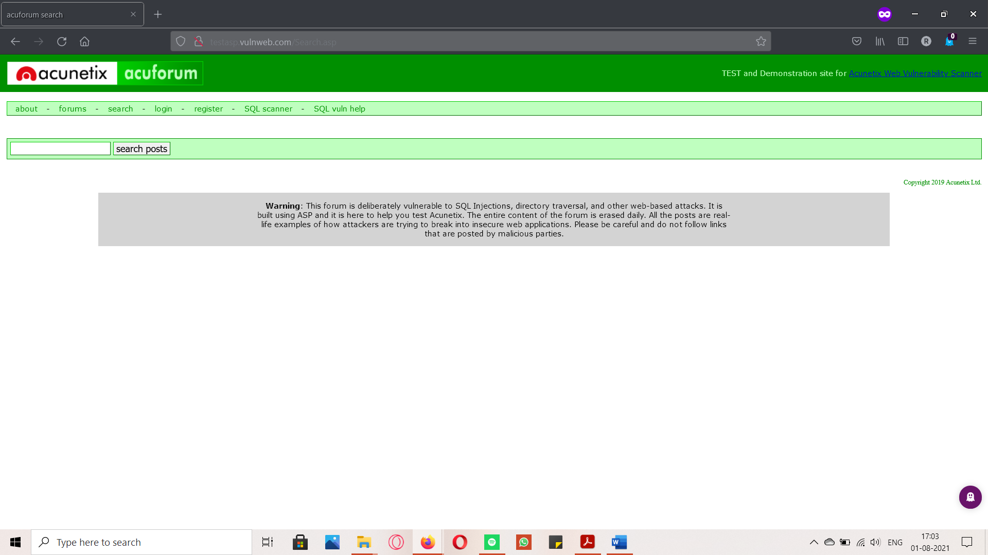
Steps to reproduce the test.
Step 1: Open the target site: http://testasp.vulnweb.com/

Slide 6
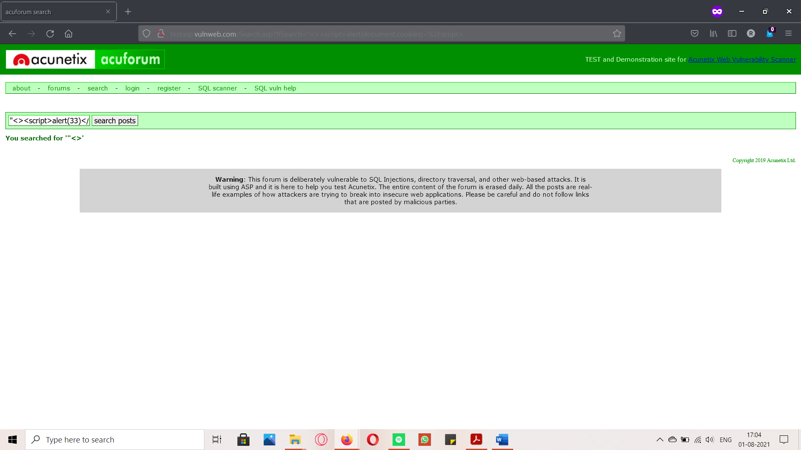
Step 2: Find a search field & type “<><script>alert(33)</script>

Slide 7
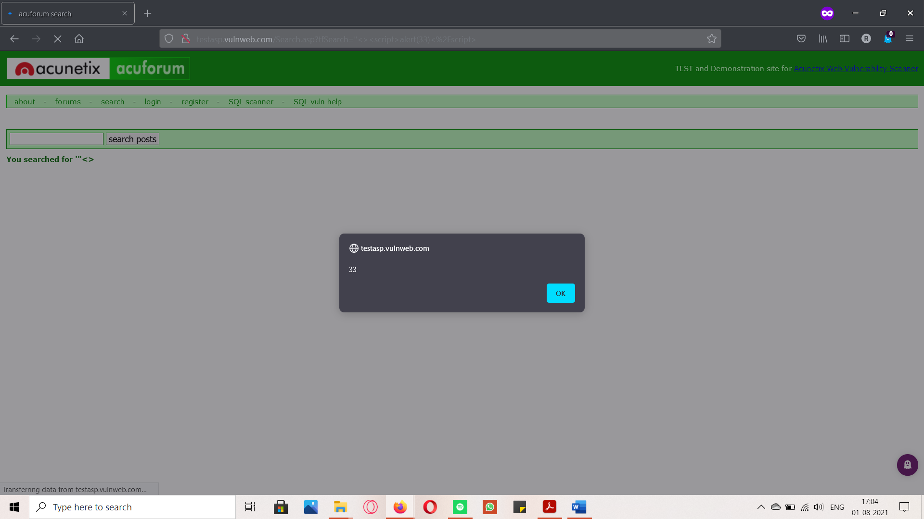
Step 3: Press enter (a pop-up is launched)

Slide 8
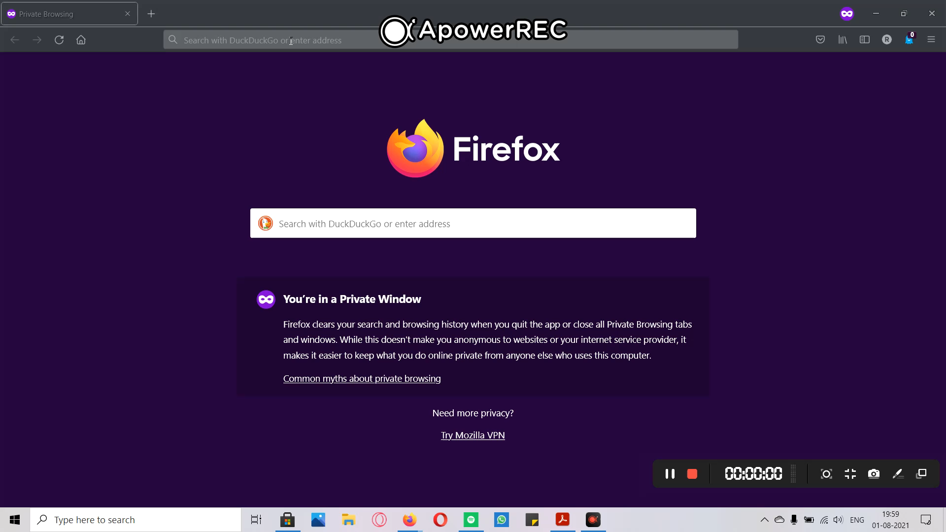
POC Video

Slide 9
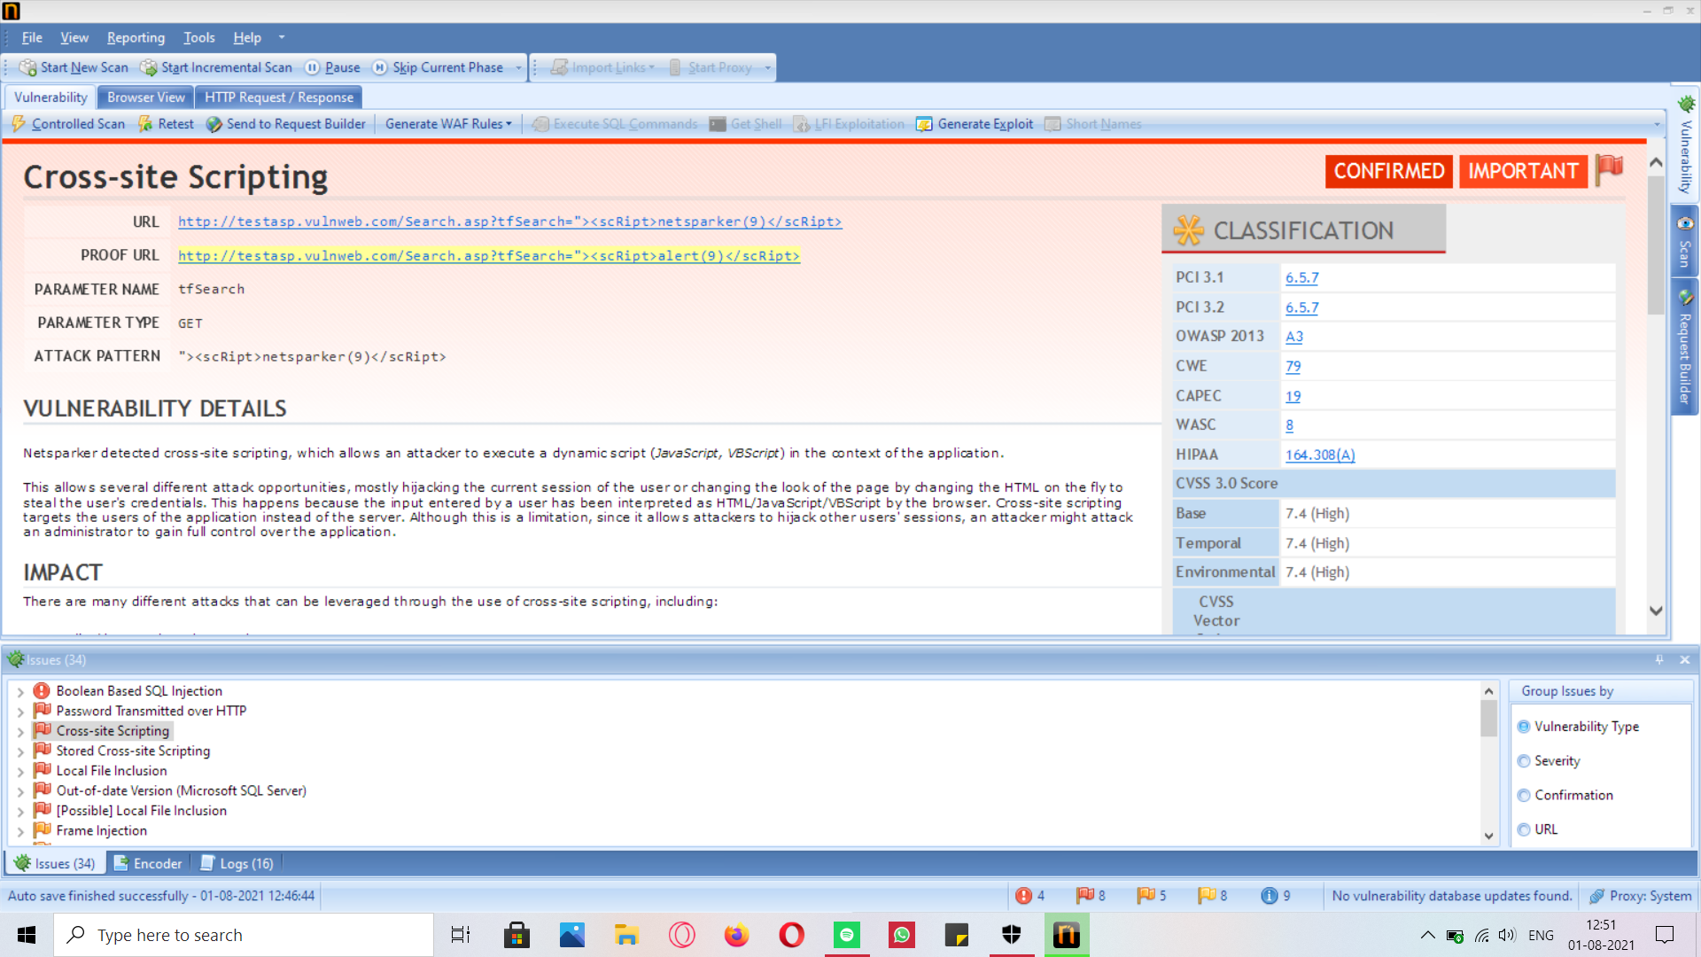
Vulnerability 1 – Netsparker Report

Slide 10
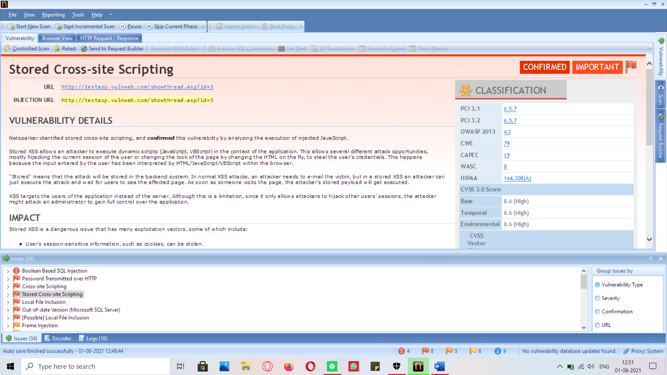
Vulnerability 2

Slide 11
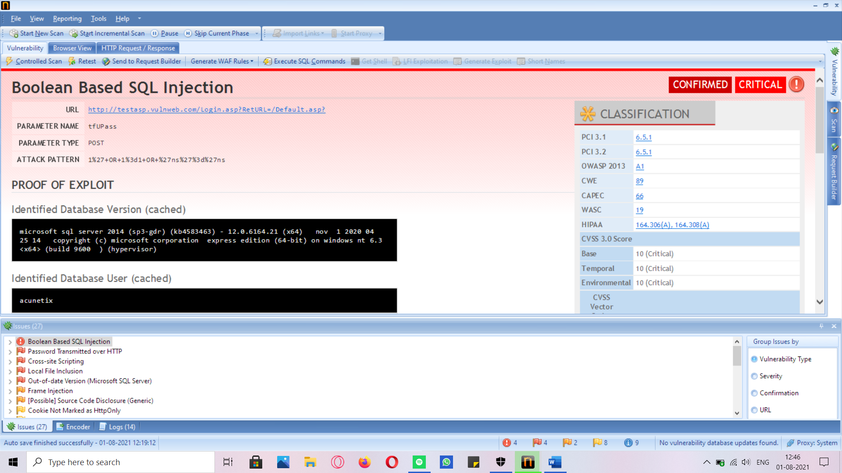
Vulnerability 3

Slide 12
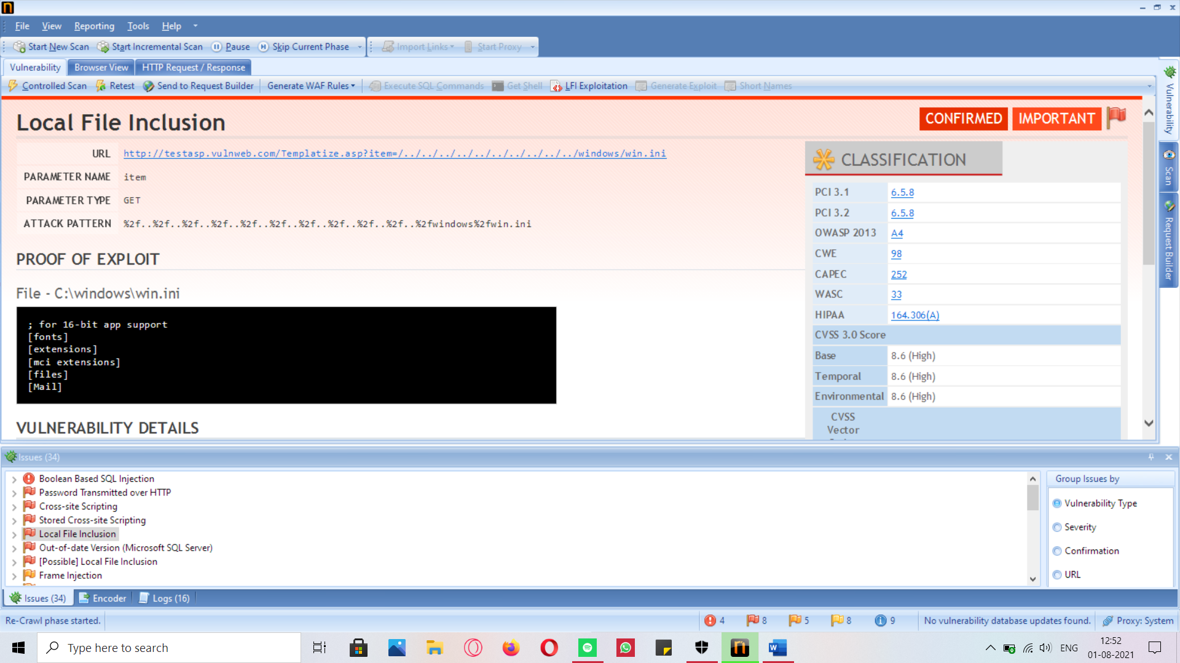
Vulnerability 4

